Slide 1



Slide 2

Agri Point
Supervised by:
Miss Tahira Sadaf
Group Members:
Mohammad Anas Khan (FA17-BCS-003)
Saif-Ur-Rehman (FA17-BCS-007)
Department of Computer Science
COMSATS University Islamabad, Attock Campus

Slide 3
Outline
Introduction
Design
Working flow
Problem statement
Objectives
Methodology
Modern tools
Benefits
_______________________________

Slide 4
Outline
Use Case
Activity Diagram
Sequence Diagram
Entity relationship diagram
Class Diagram
Data Flow Diagram
Conclusion
Future Work
_______________________________

Slide 5
Introduction
This website helps the farmers to improve their productivity.
It also helps the farmers to buy and sale the certified seeds and fertilizers etc.
In this website farmers can get information which crop to be grown for particular climate which increase the crop productivity.
Farmers can hire the laborers and get information about different products.
In addition, farmers can calculate the amount of fertilizer for land.
_______________________________

Slide 6
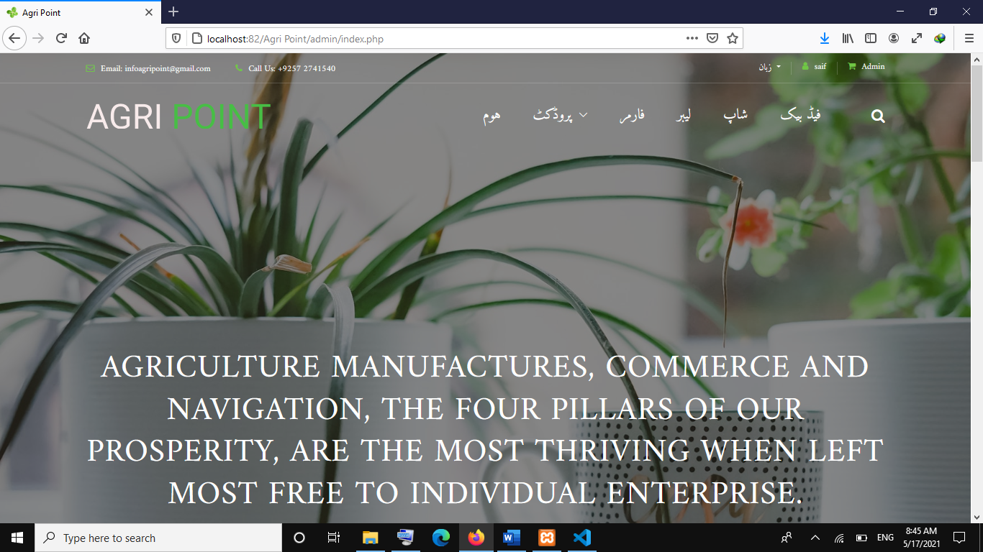
Index Page(Admin)
_______________________________

Slide 7
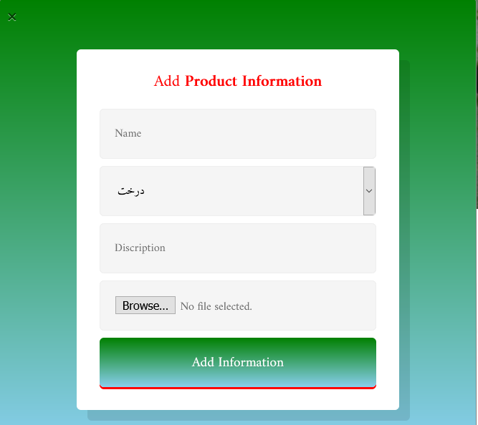
Add Product Modal
_______________________________

Slide 8
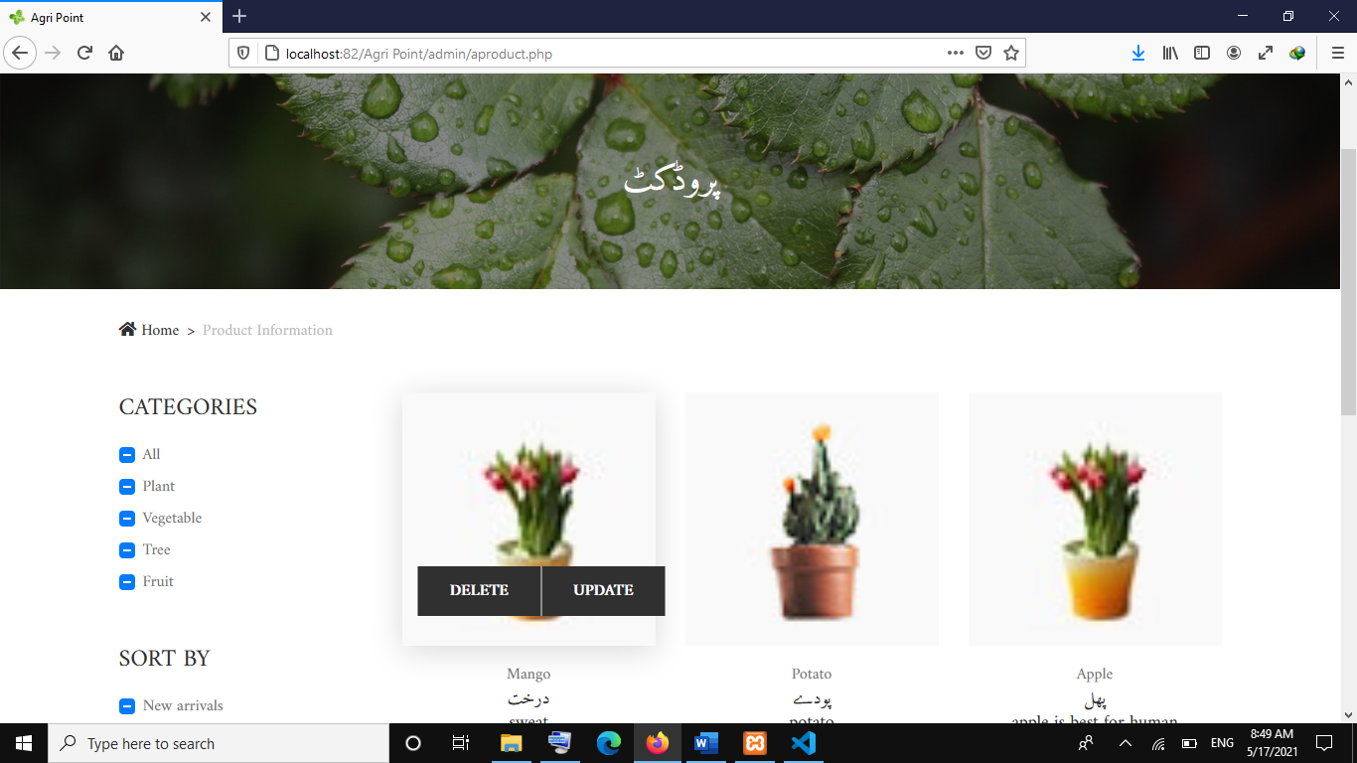
Product
_______________________________

Slide 9
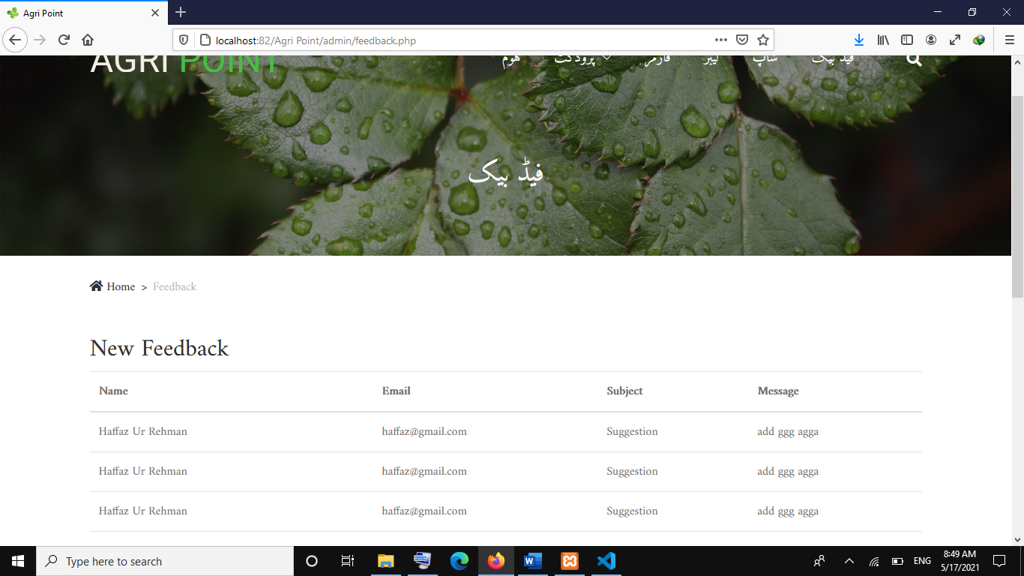
Feedback Interface
_______________________________

Slide 10
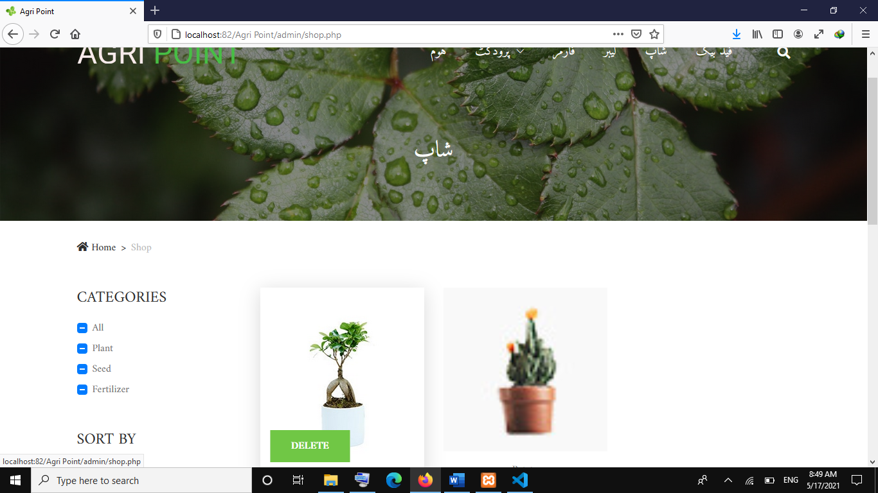
Shop Interface
_______________________________

Slide 11
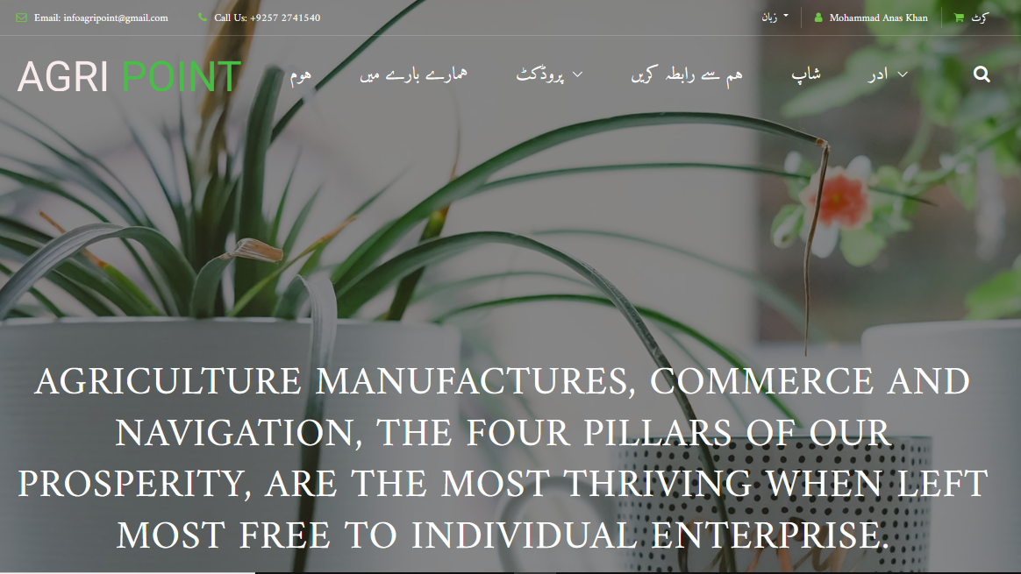
Index Page(User Interface)
_______________________________

Slide 12
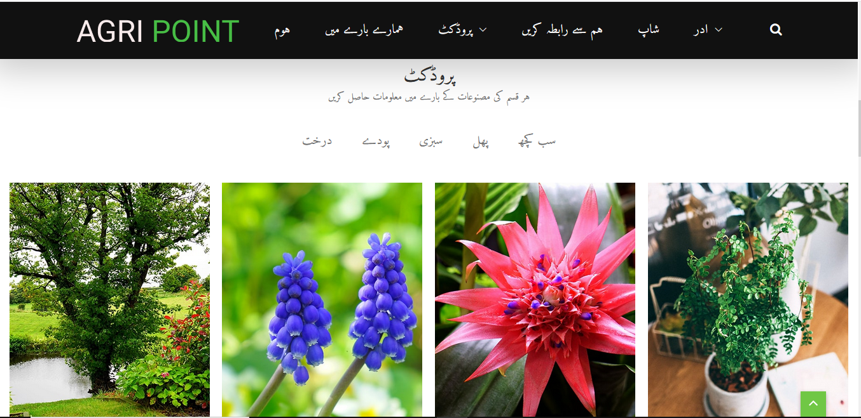
Index Page
_______________________________

Slide 13
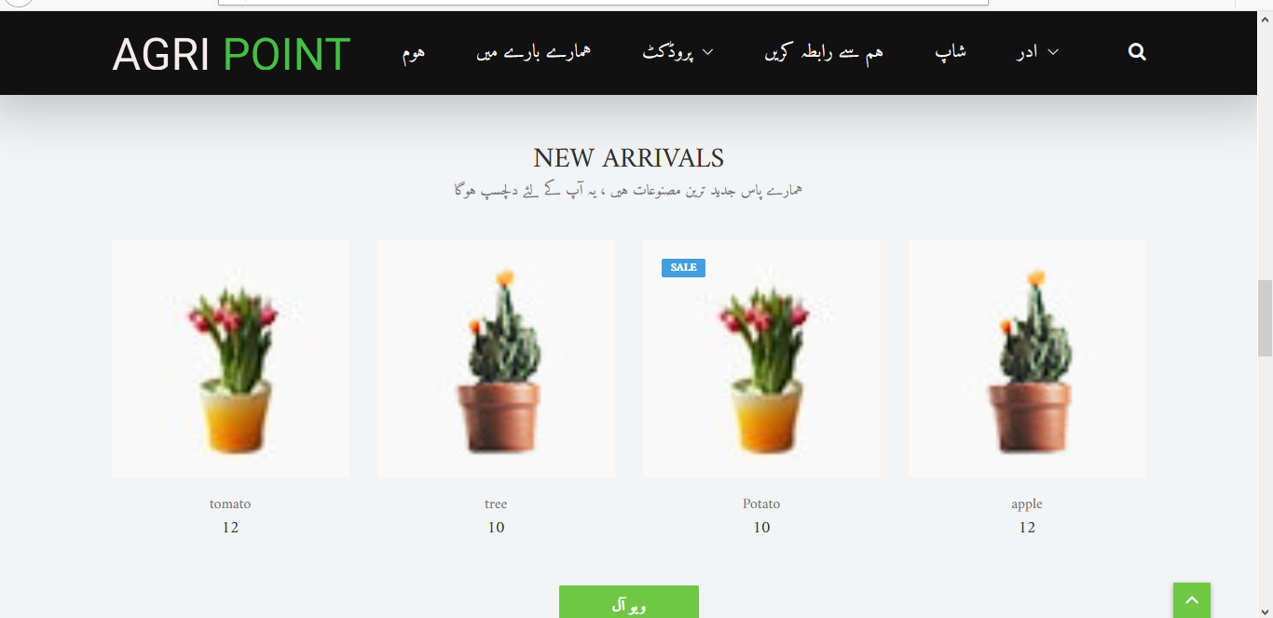
Index Page
_______________________________

Slide 14
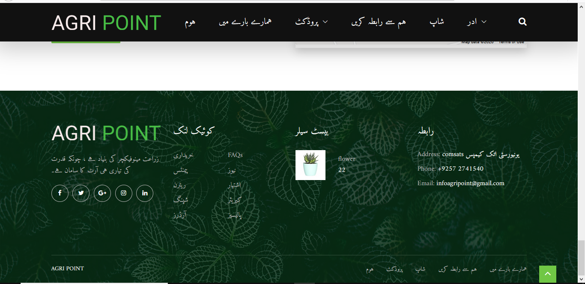
Index Page
_______________________________

Slide 15
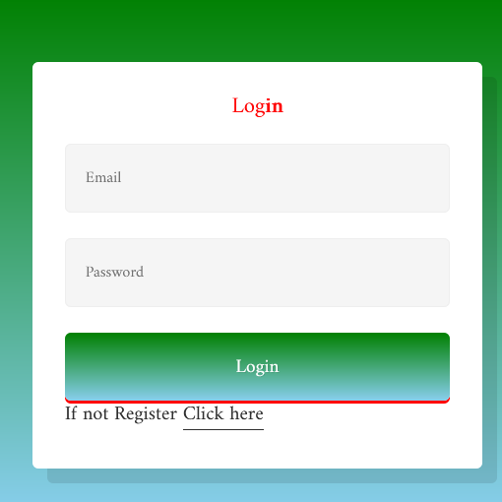
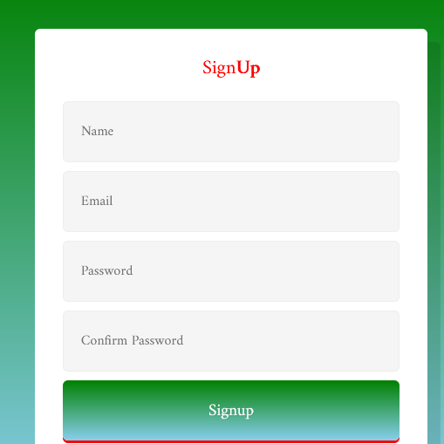
Login and Signup Modal
_______________________________

Slide 16
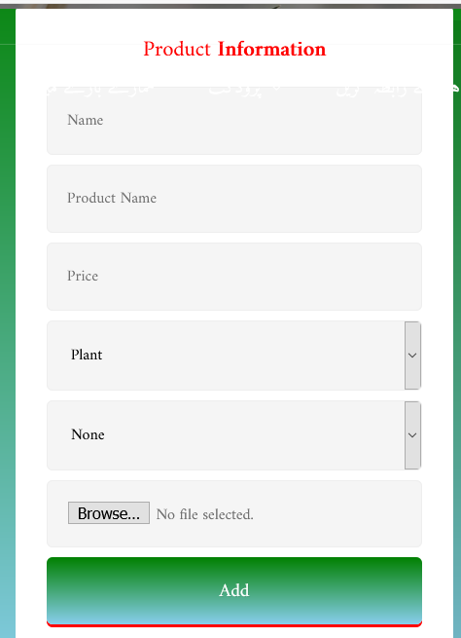
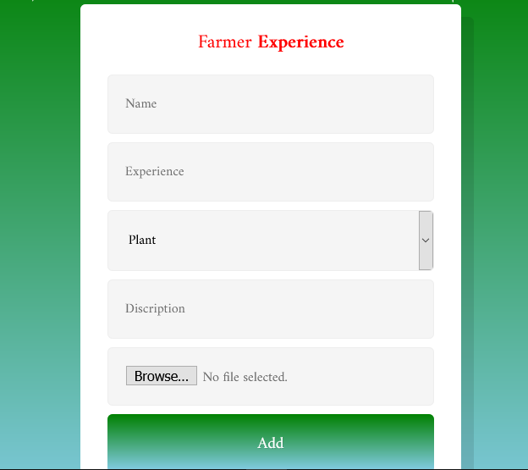
Product and Farmer Modal
_______________________________

Slide 17
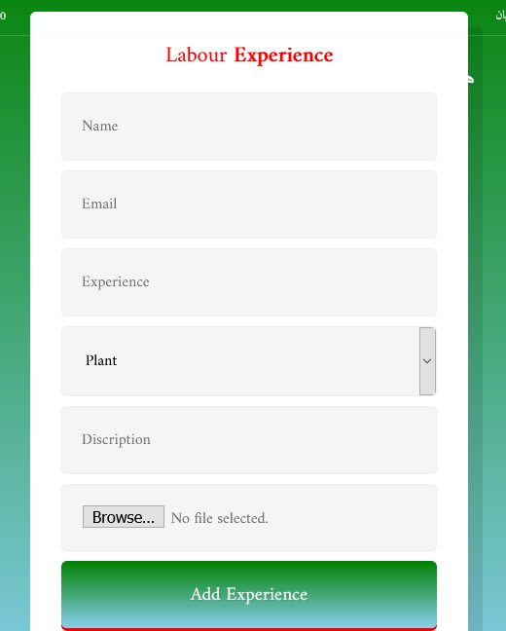
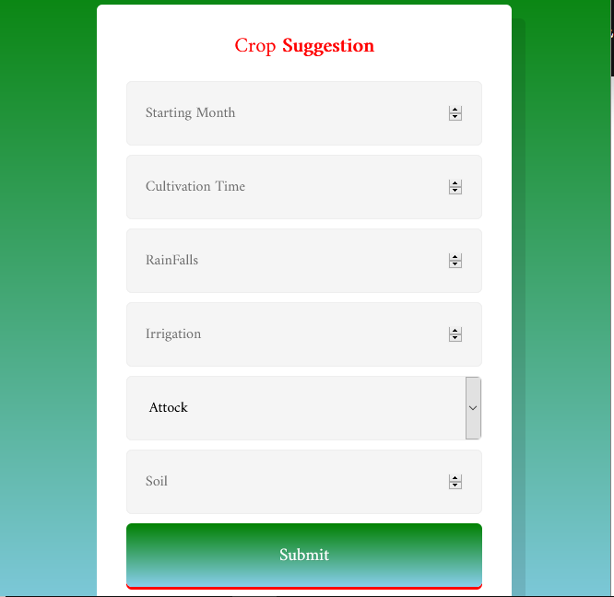
Laborer and Crop Suggestion Modal
_______________________________

Slide 18
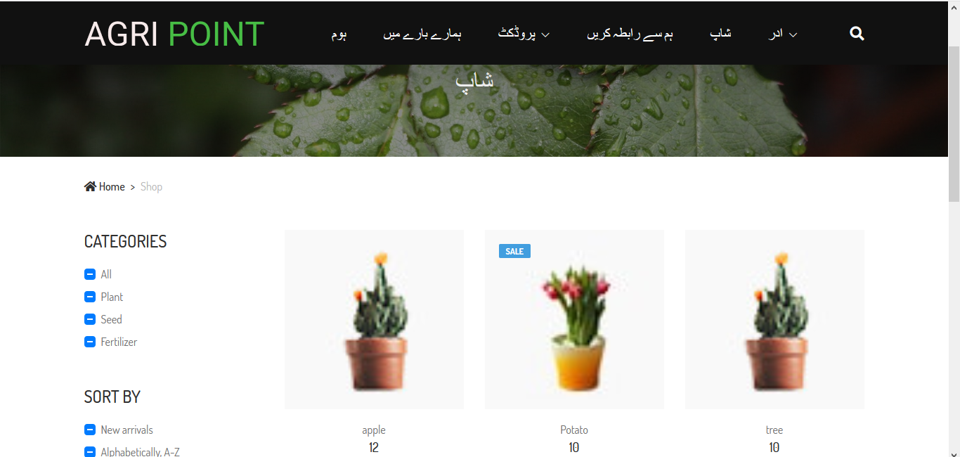
Shop Page
_______________________________

Slide 19
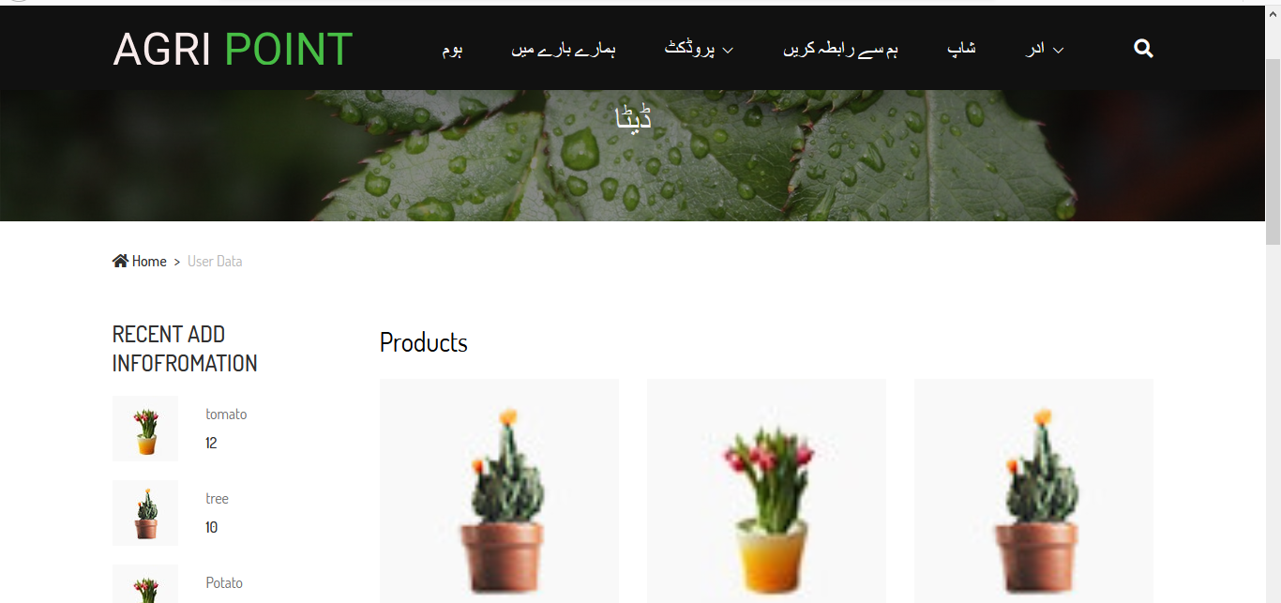
Data Page
_______________________________

Slide 20
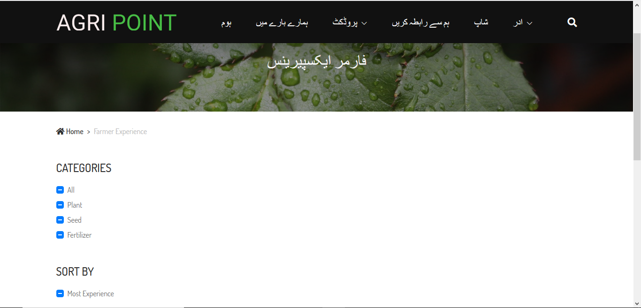
Farmer Experience Page
_______________________________

Slide 21
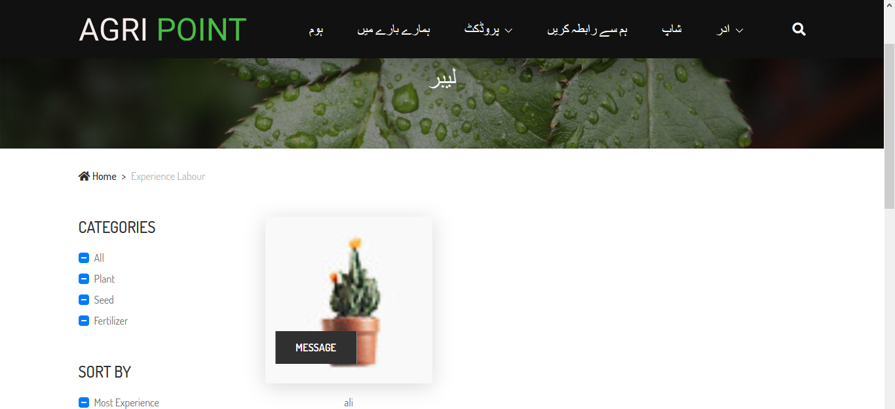
Laborer Page
_______________________________

Slide 22
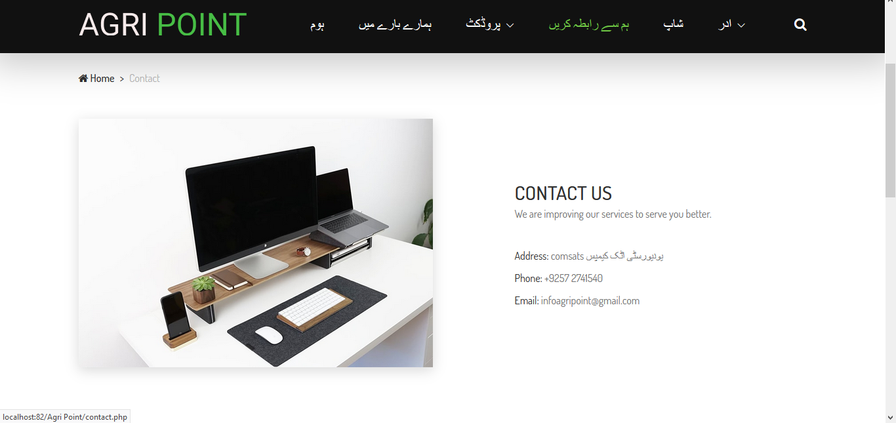
Contact Us Page
_______________________________

Slide 23
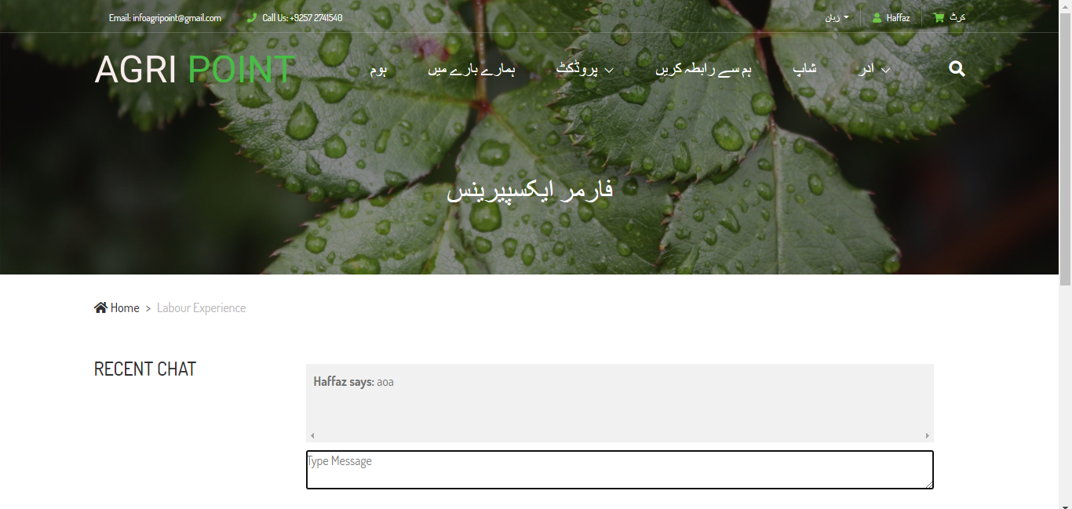
Message Page
_______________________________

Slide 24
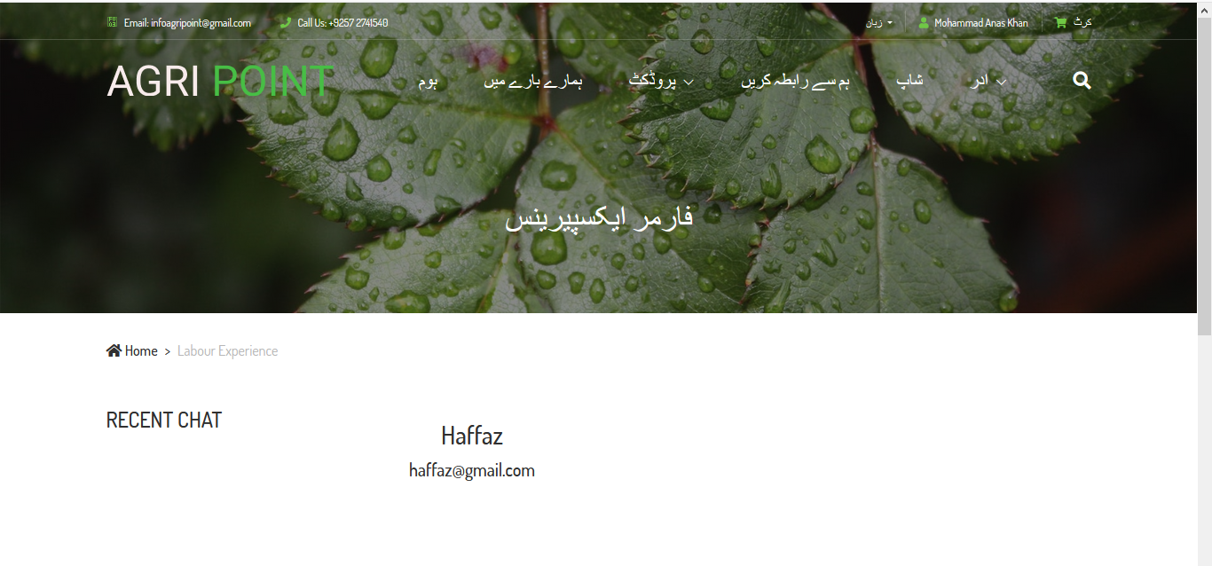
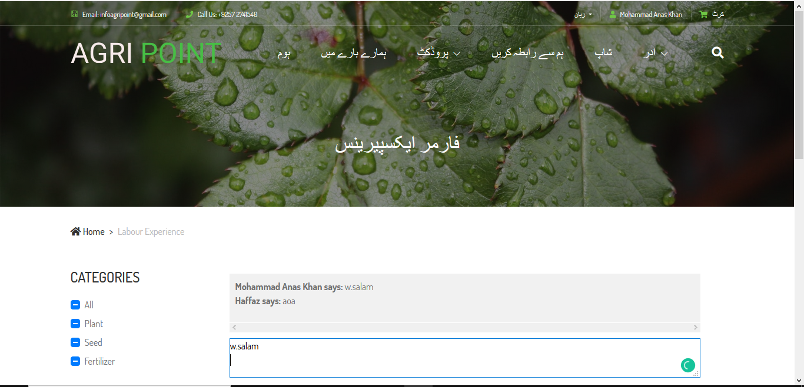
Message Page
_______________________________

Slide 25
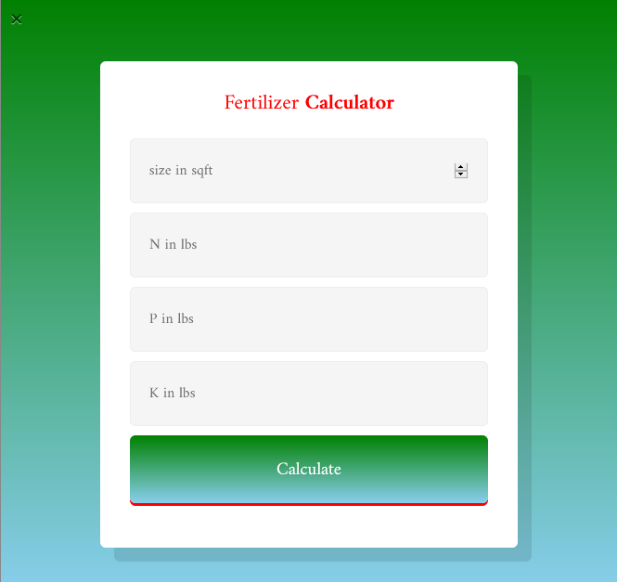
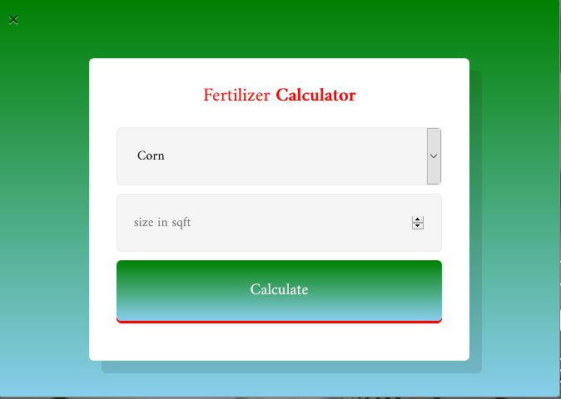
Calculator
_______________________________

Slide 26
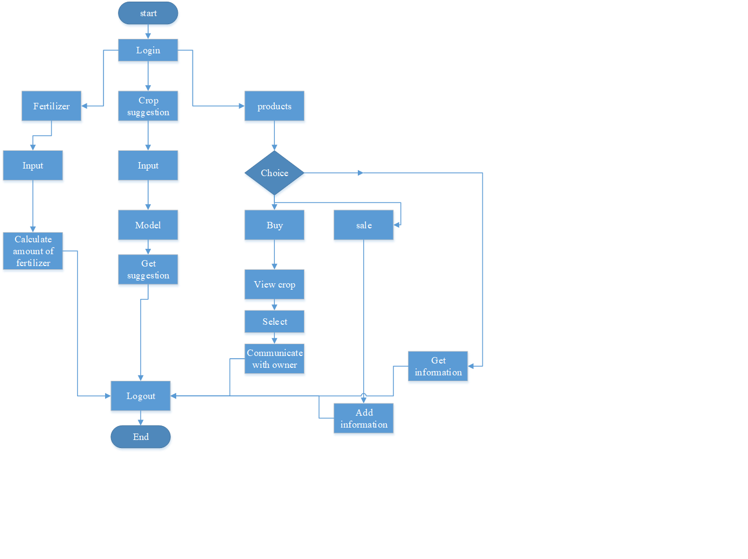
Working flow
_______________________________

Slide 27
Problem statement
Our system will help the users to get almost every type of information about agriculture. User can sale or buy crops, agriculture equipment etc. Fertilizer calculator and crop suggestion based on weather will be available on website to help farmers to increase their productivity. In this website farmers will get information about new crops and the innovative ideas related to crops, new disease, new scheme etc.
_______________________________

Slide 28
Objectives
Helps the farmers to buy and sale Agriculture products.
It provides different information about Agriculture.
Different national and international information (news) about crops.
Crop suggestion according to weather and location.
Calculate doze of fertilizer for different crops.
_______________________________

Slide 29
Cont.…
Laborers can register themselves and farmers can hire laborers according to their need.
Farmers can share their views and their experience.
_______________________________

Slide 30
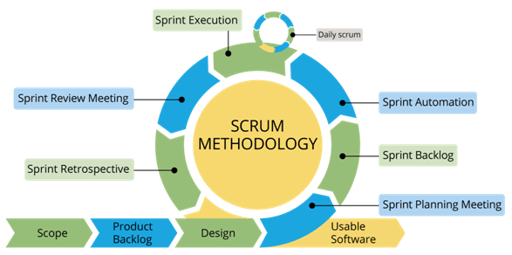
Rationale behind Selected Methodology
Selection of this methodology as we are developing in increment forms so if change require after result showing to supervisor.
_______________________________

Slide 31
Modern tools
Tools And Technologies | Tools | Version | Rationale
 | MS Word | 360 | Documentation
 | Power Point | 360 | Presentation
 | Sublime | 4 | Html/CSS
 | Vs for code/ Jupyter Notebook
 | Technology | Version | Rationale
 | HTML | 5 | Web Development
 | Java script |  | Frontend programming
 | PostgreSQL |  | Database
 | CSS/BOOTSTRAP |  | Designing
 | Python |  | Programming Language
 | PHP |  | Backend
_______________________________

Slide 32
Benefits
Farmer can sale or buy any Agricultural Product.
Users can get different information about agriculture Products
User can get crop suggestion based on temperature and location.
User can calculate the doze of fertilizer for various soil types and crops.
_______________________________

Slide 33
Cont.…
Laborers can register themselves and farmers can heir laborers according to their need.
Farmers can share their views and their experience. They can interact with fellow farmers and agricultural expert there.
Farmers can add there experience where other user get information about crops.
_______________________________

Slide 34
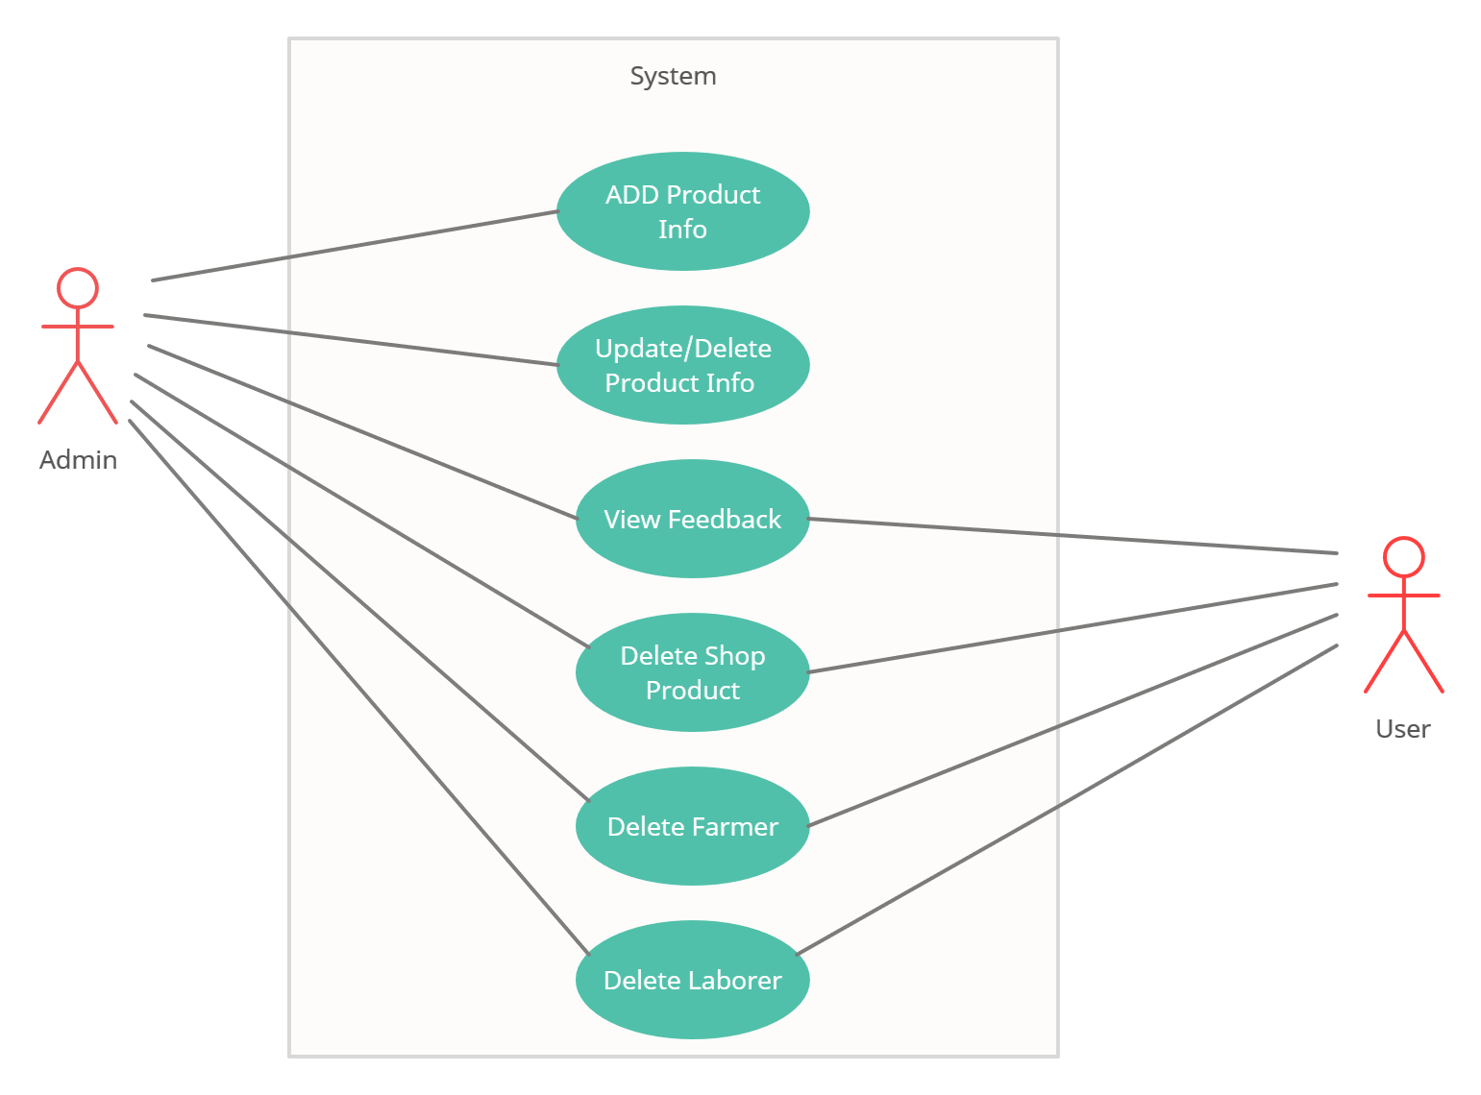
Use Case(Admin)
_______________________________

Slide 35
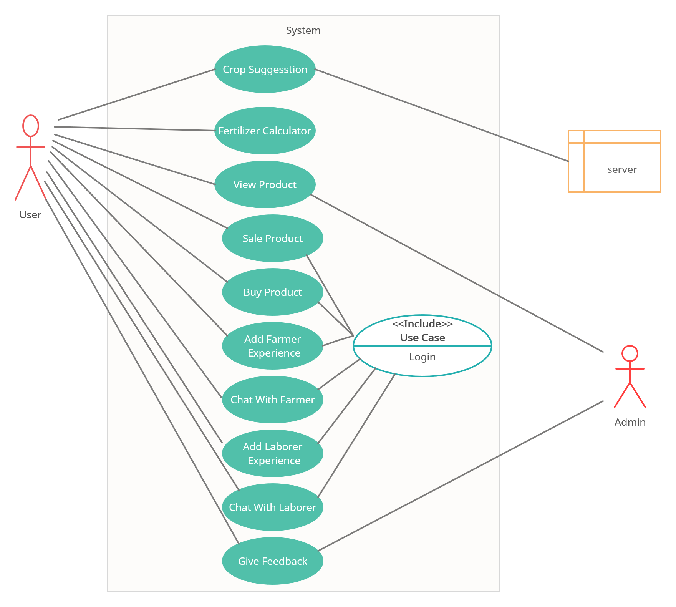
Use case(User)
_______________________________

Slide 36
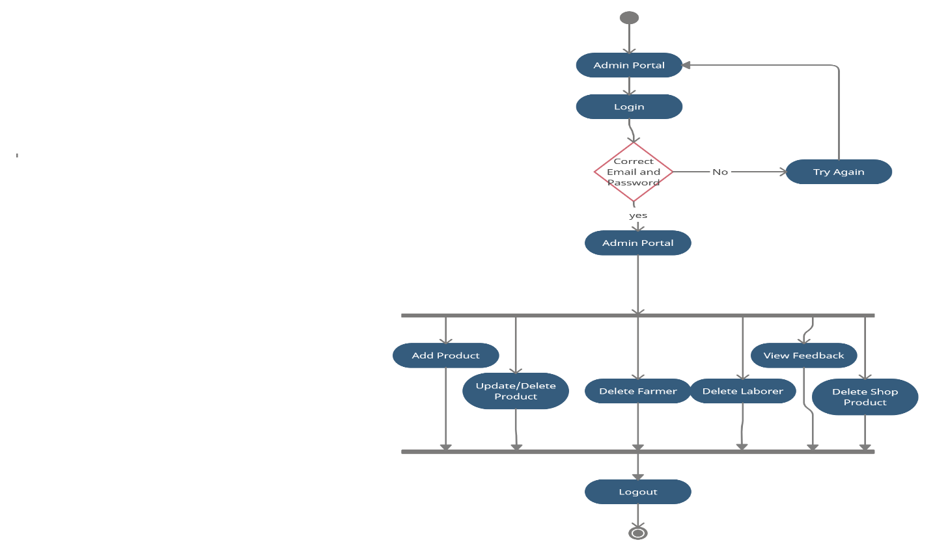
Activity Diagram(Admin)
_______________________________

Slide 37
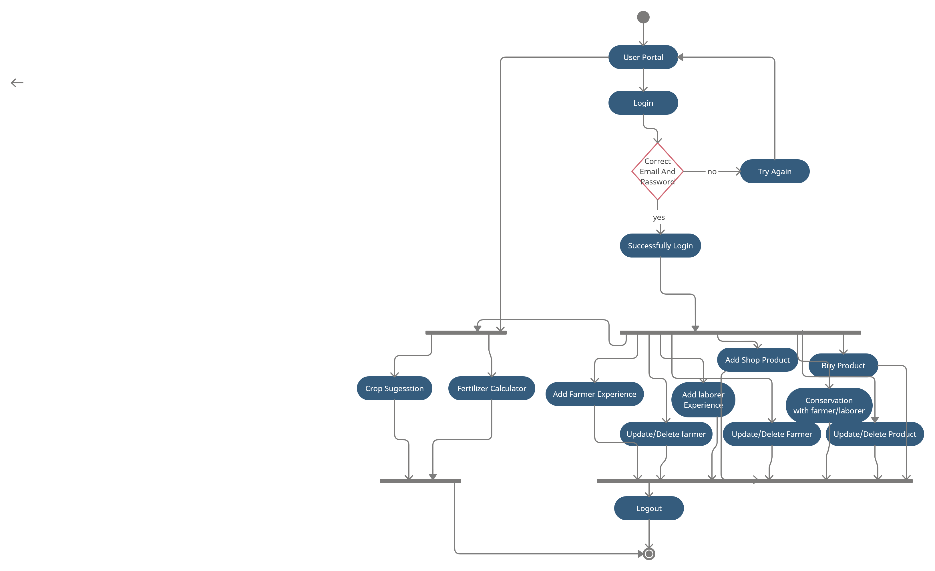
Activity Diagram(User)
_______________________________

Slide 38
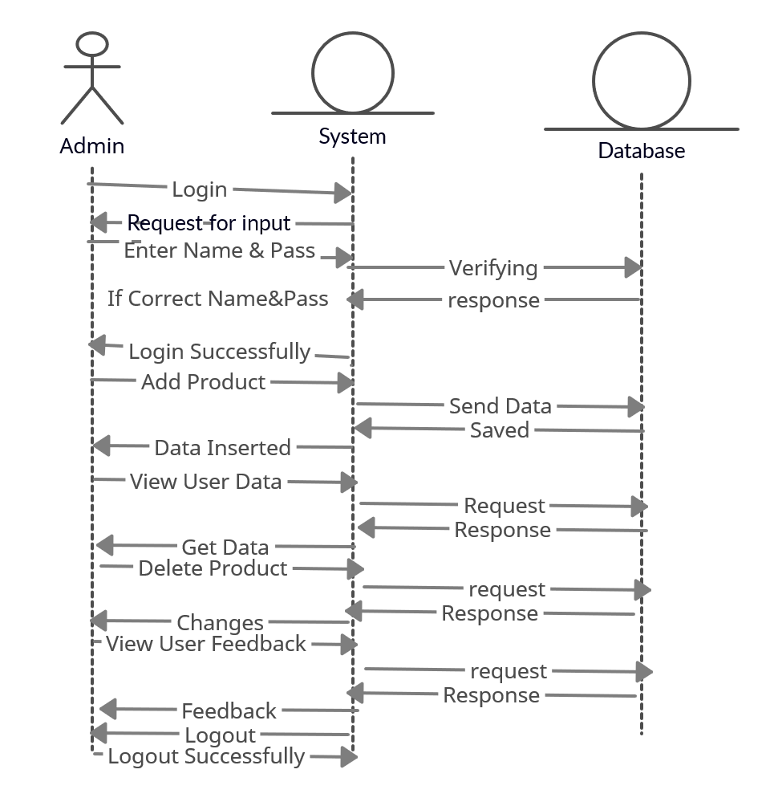
Sequence Diagram(Admin)
_______________________________

Slide 39
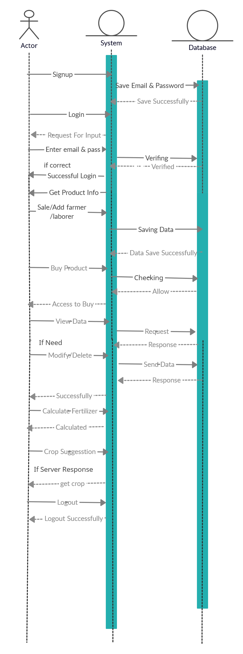
Sequence Diagram(User)
_______________________________

Slide 40
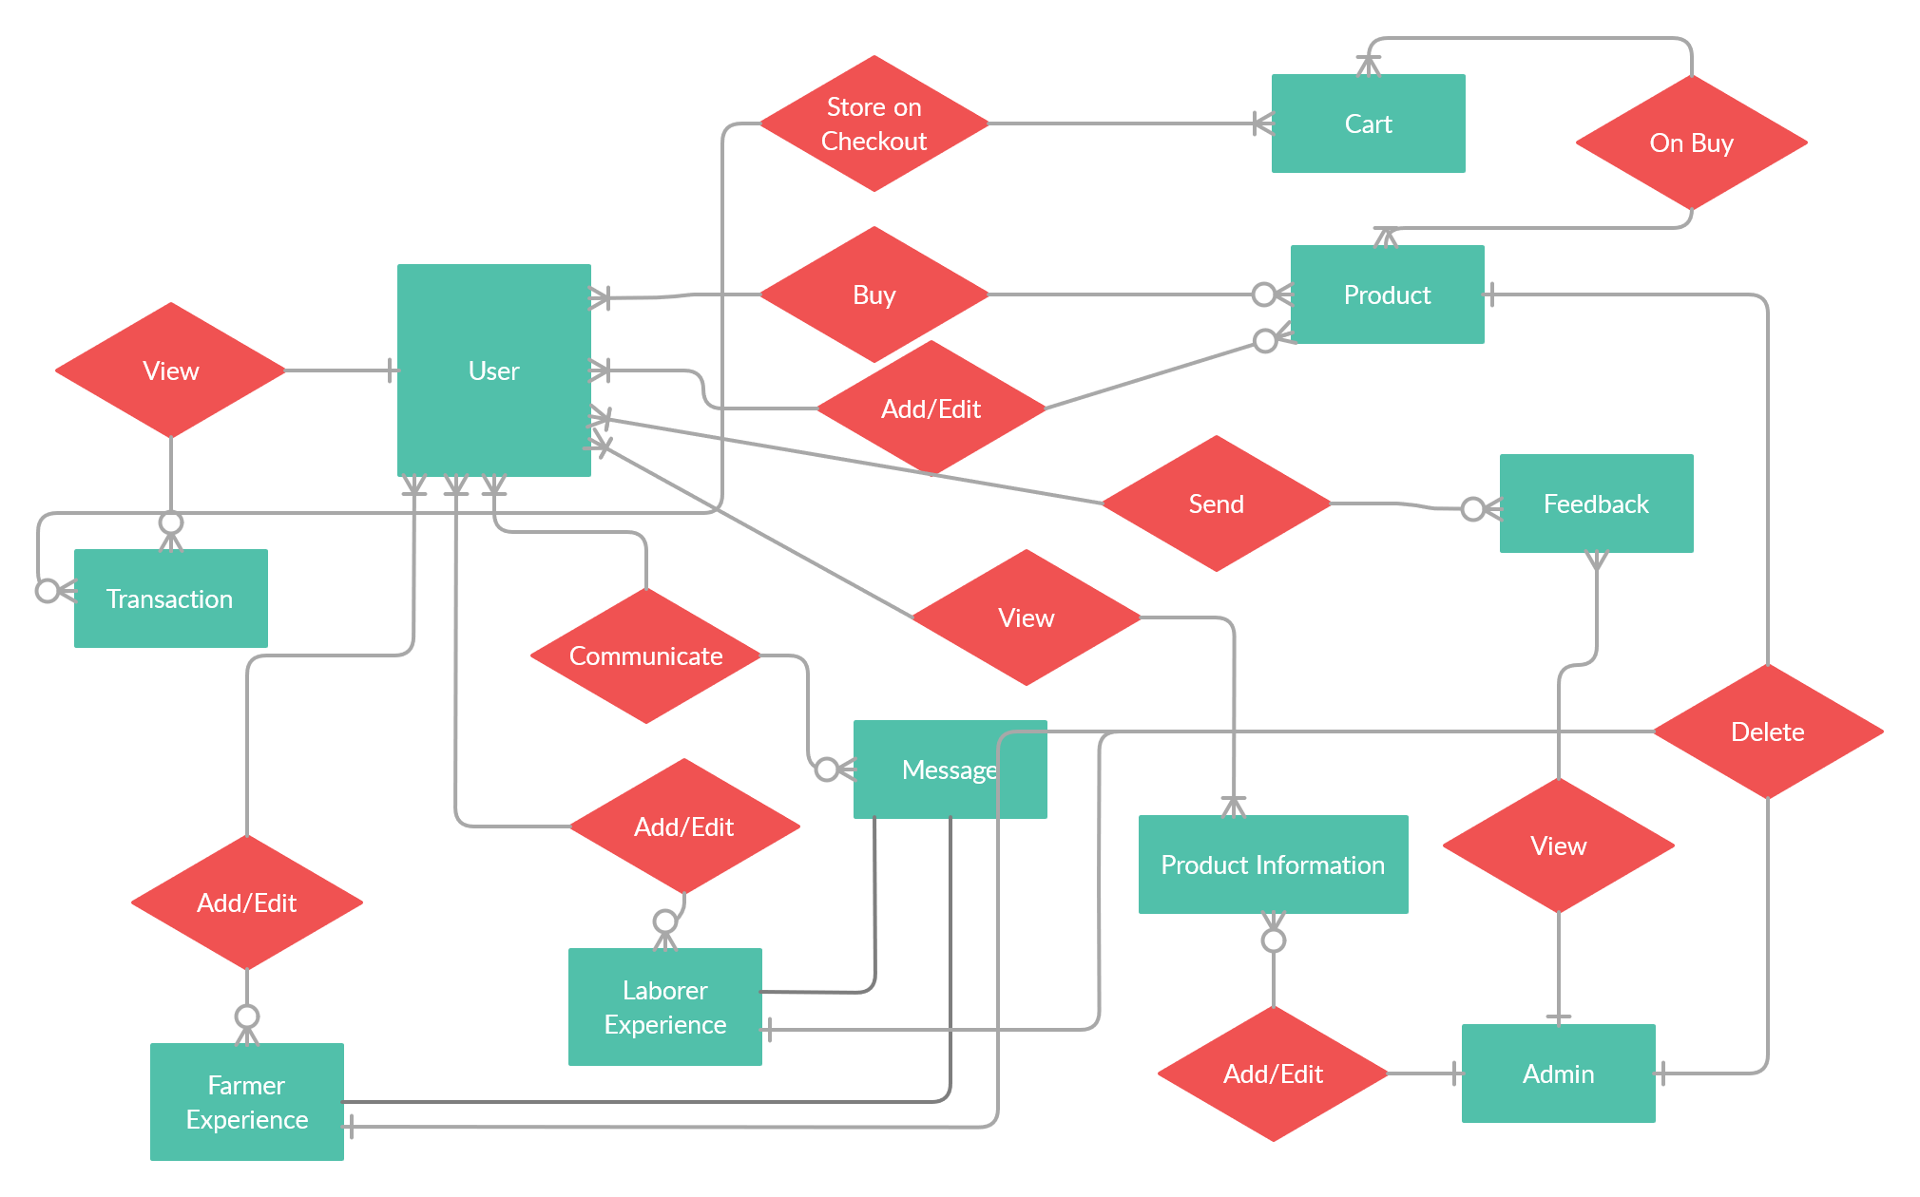
Entity relationship diagram
_______________________________

Slide 41
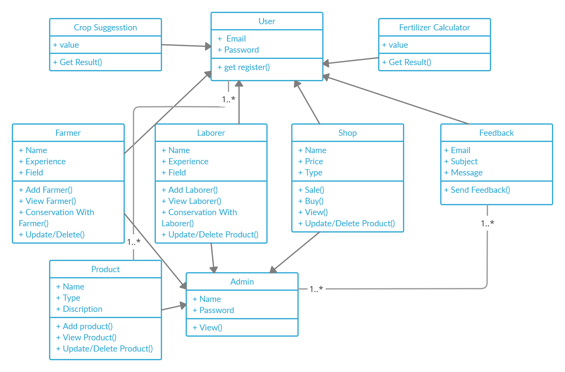
Class Diagram
_______________________________

Slide 42
DFD Level 0
Agri Point
User
Admin
_______________________________

Slide 43
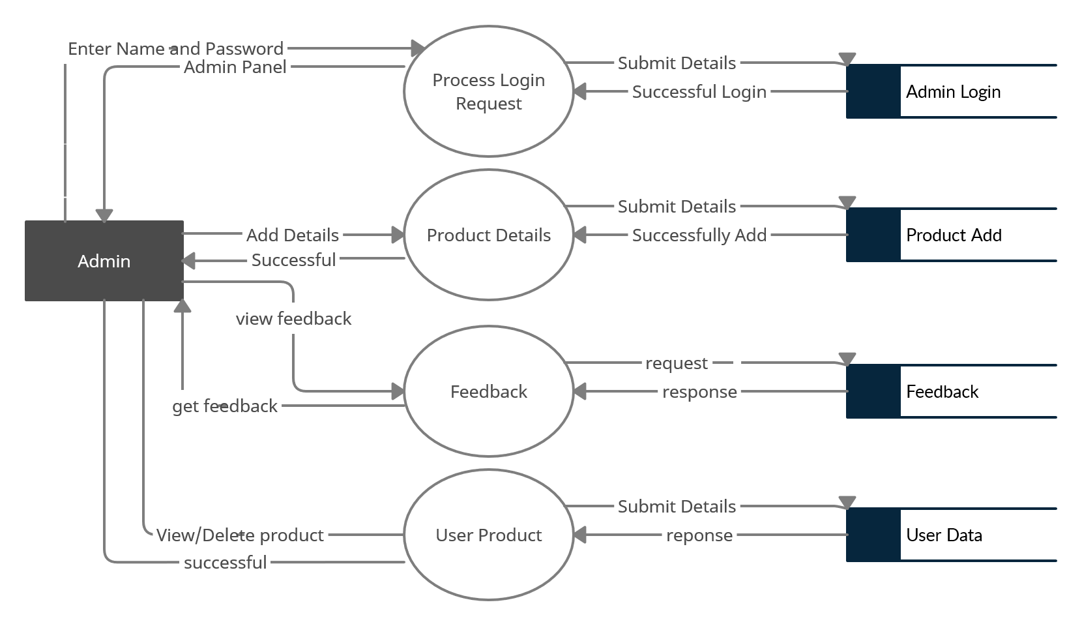
DFD Level 1(Admin)
_______________________________

Slide 44
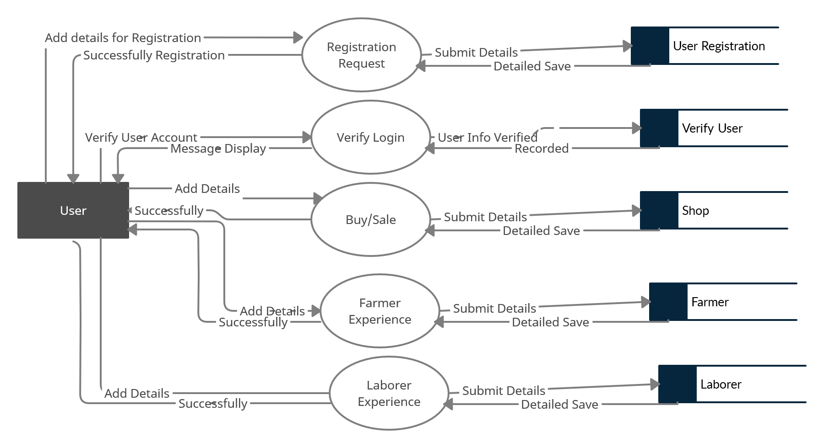
DFD Level 1(User)
_______________________________

Slide 45
Conclusion
Farmers came across various problems while performing out their duties, so in order to get them out of this havoc, we had undertaken this very project.
In this project, we developed a web based Agricultural system, which will surely help the Farmers to grow crops according to the situation of temperature, soil and will eventually get larger amount of production
_______________________________

Slide 46
Cont.
It will also help the individual farmers to calculate recommended of fertilizer for each crop.
In addition to that this system has an option where farmers can buy inputs i.e., seeds, fertilizers etc. and to sale out their products.
Along with that this system also has an information tab where farmers can get information about agriculture from agricultural experts through messaging.
_______________________________

Slide 47
Cont.
Farmer can heir laborer according to their needs.
So, by keeping this in mind, we designed the Agri point system with local database. There are two type of users of this system: Admins and User. Admins manage the system. Both have their own portal admin portal and user portal.
_______________________________

Slide 48
Future Work
In future this work can be shifted to android application with minimal internet requirement.
Another module can be added which can bring in call feature for interaction of farmers and laborer.
Crop disease detection and advisory feature can be added by utilizing artificial intelligence.
_______________________________

